Slide 1

Suvival analysis in R
Adapted from Jenny Bryan’s Stat 545 course : https://bioconnector.github.io/workshops/r-survival.html

Slide 2





Some articles using the surival analysis
https://www.frontiersin.org/articles/10.3389/fgene.2020.574661/full
https://www.nature.com/articles/s41467-021-23384-6
https://www.nature.com/articles/s12276-019-0319-y
https://onlinelibrary.wiley.com/doi/epdf/10.1002/ijc.33512
https://www.nature.com/articles/s41467-020-18613-3

Slide 3



Concepts
1. Therory:
Hazard
Survival function
Kaplan Meier Curve
Censoring
Cox propotional harzard model: univariate and multivariate analysis
2. Practise survival analysis in R with R dataset
Survival curve
Kaplan Meier (KM) plot
Cox Regression
2* Application using the dataset in TCGA using packages:
RTCGA
TCGAworkflow
http://www.sthda.com/english/wiki/cox-model-assumptions
https://towardsdatascience.com/survival-analysis-intuition-implementation-in-python-504fde4fcf8e

Slide 4
1. Theory:
Hazard
Survival function
Kaplan Meier Curve
Censoring
Cox propotional harzard model: univariate and multivariate analysis

Slide 5
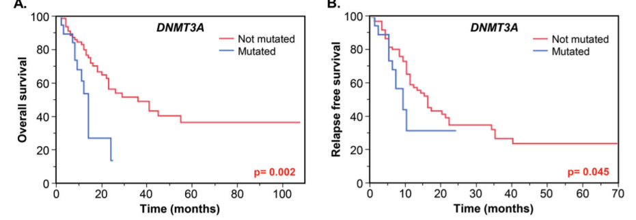
1. Theory:
Hazard
Survival function
Kaplan Meier Curve
Censoring
Cox propotional harzard model: univariate and multivariate analysis
- Survival analysis lets you analyze the rates of occurrence of events over time, without assuming the rates are constant. Generally, survival analysis lets you model the time until an event occurs,1 or compare the time-to-event between different groups, or how time-to-event correlates with quantitative variables:
- The event may be:
Overall survival: OS
Disease free survival: DFS
Relapse/ Recurrence free survival: RFS
Progression free survival: PFS

Slide 6
1. Theory:
Hazard
Survival function
Kaplan Meier Curve
Censoring
Cox propotional harzard model: univariate and multivariate analysis
The hazard is the instantaneous event (death) rate at a particular time point t. Survival analysis doesn’t assume the hazard is constant over time. The cumulative hazard is the total hazard experienced up to time t.
The survival function, is the probability an individual survives (or, the probability that the event of interest does not occur) up to and including time t. It’s the probability that the event (e.g., death) hasn’t occured yet. It looks like this,
Where :
+ T is the time of death, and Pr(T>t) is the probability that the time of death is greater than some time t.
+ S is a probability, so 0≤S(t)≤1, since survival times are always positive (T≥0).
S(t)=Pr(T>t)
The Kaplan-Meier curve illustrates the survival function. It’s a step function illustrating the cumulative survival probability over time. The curve is horizontal over periods where no event occurs, then drops vertically corresponding to a change in the survival function at each time an event occurs.

Slide 7
1. Theory:
Hazard
Survival function
Kaplan Meier Curve
Censoring
Cox propotional harzard model: univariate and multivariate analysis
Censoring is a type of missing data problem unique to survival analysis. This happens when you track the sample/subject through the end of the study and the event never occurs. This could also happen due to the sample/subject dropping out of the study for reasons other than death, or some other loss to followup. The sample is censored in that you only know that the individual survived up to the loss to followup, but you don’t know anything about survival after that.2
Survival analysis doesn’t assume that the hazard is constant, but does assume that the ratio of hazards between groups is constant over time

Slide 8
1. Theory:
Hazard
Survival function
Kaplan Meier Curve
Censoring
Cox propotional harzard model: univariate and multivariate analysis
Cox PH regression models the natural log of the hazard at time t, denoted h(t), as a function of the baseline hazard (h0(t)) (the hazard for an individual where all exposure variables are 0) and multiple exposure variables x1, x1, ..., xp. The form of the Cox PH model is:
ln(h(t))=ln(h0(t))+β1x1+β2x2+...+βpxp
Single categorical exposure variable (x1) with two groups (x1=1 for exposed and x1=0 for unexposed), the equation becomes:
ln(h(t))=ln(h0(t))+β1x1
Exponentiated both side:
e^{ln(h(t))}=e ^{ln(h0(t))+B1x1}
<=>h(t)=e^{h0(t)} *e^{B1x1}
<=>h(t)=h(0)*e^{B1x1}
<=>h(t)/h(0)=e^{B1x1}
Let x1=1 then the final equation is : h(t)/h(0)=e^{B1}
ln= log _{e}(X)

Slide 9
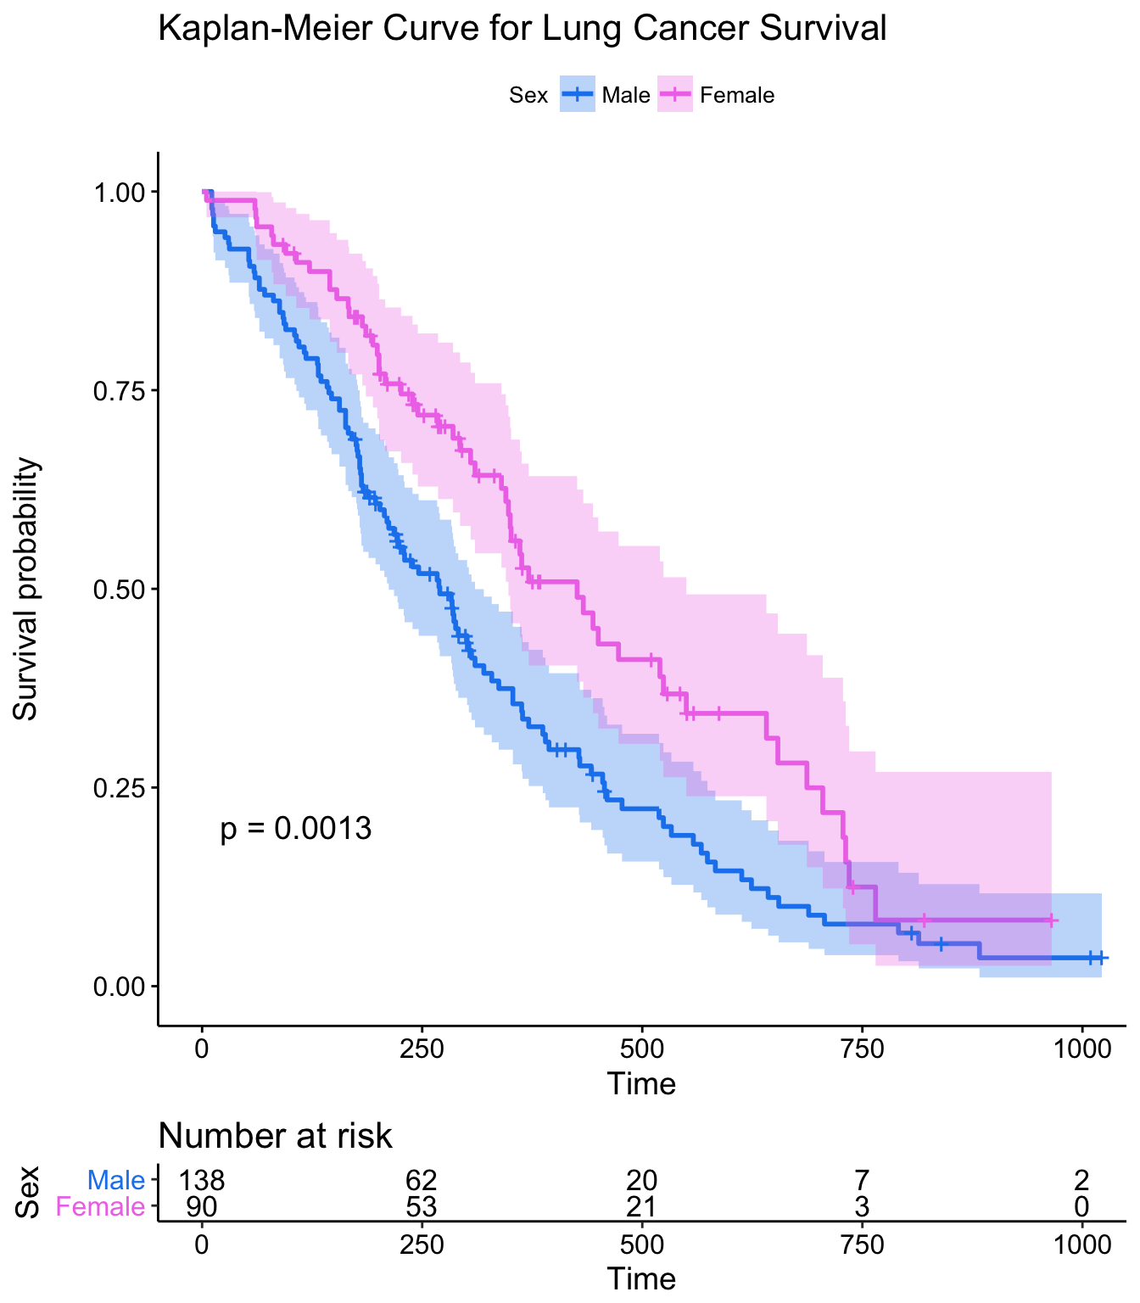
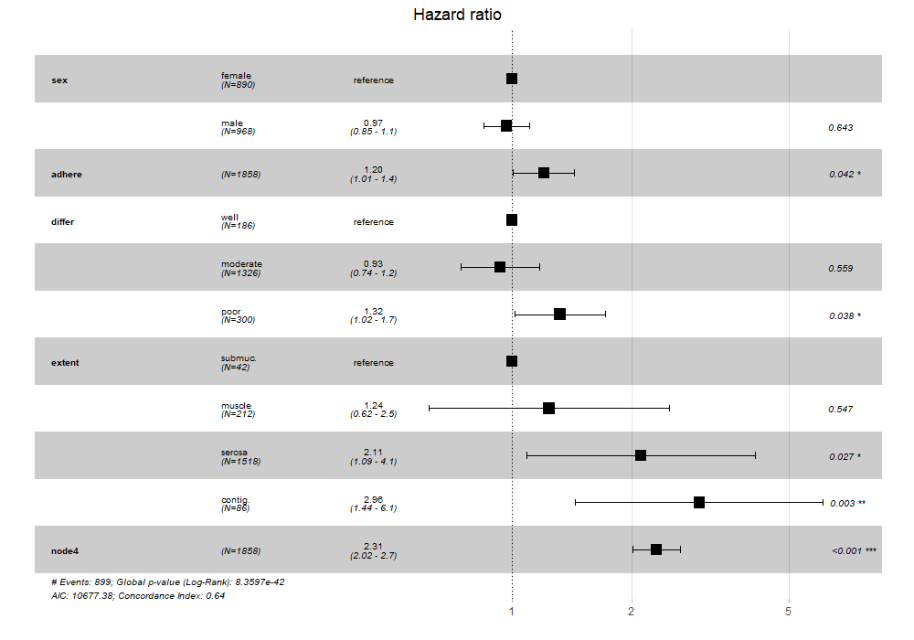
1. Theory:
Hazard
Survival function
Kaplan Meier Curve
Censoring
Cox propotional harzard model: univariate and multivariate analysis

Slide 10

2. Practise
Source for survival data
https://kmplot.com/analysis/
TCGA
http://gdac.broadinstitute.org/runs/info/clinical/
GEO
EGA

